Slide 1
Chapter 7 Test Tools
This chapter gives an overview of the different test tools. Topics include how to choose and introduce these tools and the preconditions for using them.
7.1 Types of Test Tools
Test tools are normally used for these purposes:
■ Improving test efficiency. Manual work, such as repetitive and timeconsuming tasks, can be automated. Static analysis and test execution are examples of tasks that can be automated.
■ Enabling tests. Tools may make it possible to execute tests that are impossible to do manually. This includes performance and load tests and tests of real-time inputs for control systems.
■ Improving test reliability. Reliability is improved by

Slide 2
Chapter 7 Test Tools
automating manual tasks like comparing large amounts of data or simulating program behavior.
Test framework is a term often used in discussions of test tools. In practice,it has at least three meanings:
■ Reusable and extensible testing libraries that can be used to build testing tools (sometimes called test harnesses)
■ The way of designing the test automation (e.g., data driven, keyworddriven)
■ The whole process of test execution
Test tools are often called CAST tools (Computer Aided Software Testing), which is derived from the term CASE tools (Computer Aided Software Engineering).

Slide 3
Chapter 7 Test Tools
7.1.1 Tools for Management and Control of Testing and Tests
Test management tools provide mechanisms for easy documentation, prioritization,listing, and maintenance of test cases. In addition, some tools support project management within testing.They help the test manager plan the tests and keep an overview of hundreds or thousands of test cases.
Advanced test management tools support requirements-based testing.In order to do this, they capture system requirements (or import them from requirements management tools) and link them to the tests.Different consistency checks may be done; for example, a test may check to see if there is at least one planned test case for every requirement.

Slide 4
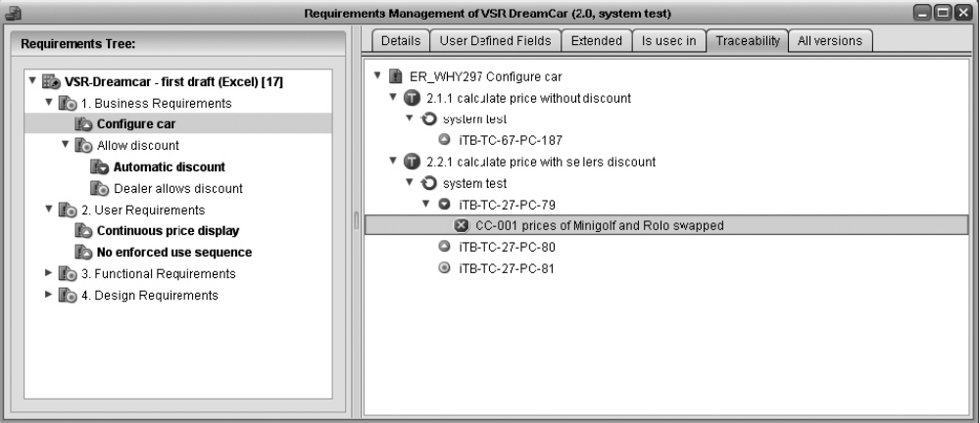
Chapter 7 Test Tools
Following Figure shows what this may look like for the CarConfigurator.
The requirement Configure car has four assigned test cases: iTB-TC-67-PC-187,iTB-TC-27-PC-79, iTB-TC-27-PC-80 and iTB-TC-27-PC-81. iTB-TC-27-PC-79found a failure and is connected to the corresponding incident report.

Slide 5
Chapter 7 Test Tools
Integrating(or seamlessly) test tools with test tools is getting more and more important. The test management tool is the key for this:
■ Requirements are imported from the requirements management tool and used for test planning. The test status for every requirement can be watched and traced in the requirements management tool or the test management tool.
■ From the test management tool, test execution tools (for example,test robots) are started and supplied with test scripts. The test results are automatically sent back and archived.
■ The test management tool is coupled with the incident management tool. Thus, a plan for retest can be generated; that is, a list of all test cases necessary to

Slide 6
Chapter 7 Test Tools
verify which defects have been successfully corrected in the latest test object version.
■ Finally, through configuration management, every code change is connected to the triggering incident or the change request causing it.
Such a tool chain makes it possible to completely trace the test status from the requirements through the test cases and test results to the incident reports and code changes.
7.1.2 Tools for Test Specification
In order to make test cases reproducible, the pre- and postconditions as well as test input data and expected results need to be specified.So-called test (data) generators can support the test designer in generating

Slide 7
Chapter 7 Test Tools
test data. Several approaches can be distinguished, depending on the test basis used for deriving the test data:
■ Database-based test data generators process database schemas and are able to produce test databases from these schemas.A similar process is the generation of test data from files in different data formats.
■ Code-based test data generators produce test data by analyzing the test object’s source code.
■ Interface-based test data generators analyze the test object’s interface and identify the interface parameter domains and use.For example,equivalence class partitioning and boundary value analysis can be used to derive test data from these domains.

Slide 8
Chapter 7 Test Tools
■ Specification-based test data generators use a specification to derive test data and corresponding expected results. A precondition is that the specification is available in a formal notation. For example, a UML message sequence chart may describe a method-calling sequence. This approach is called model-based testing (MBT). The UML model is designed using a CASE tool and is then imported to the test generator. The test generator generates test scripts, which are then passed on to a suitable test execution tool.
Test tools cannot work miracles. Specifying tests is a very challenging task,requiring not only a comprehensive understanding of the test object but also creativity and intuition. A test data generator can apply certain rules (e.g., boundary value analysis) for systematic test

Slide 9
Chapter 7 Test Tools
generation. However, it cannot judge whether the generated test cases are suitable, important, or irrelevant. The test designer must still perform this creative analytical task.The corresponding expected result must be determined and added manually too.
7.1.3 Tools for Static Testing
Static analysis can be executed on source code or on specifications before there are executable programs. Tools for static testing can therefore be helpful to find faults in early phases of the development cycle. Faults can be detected and fixed soon after being introduced and thus dynamic testing will be less riddled with problems, which decreases costs and development time.
Reviews are structured manual examinations using the principle that four eyes find more defects than two

Slide 10
Chapter 7 Test Tools
Review support tools help to plan, execute, and evaluate reviews.Tools for review support are also especially useful when large, geographically distributed projects use several teams. Online reviews can be useful here and even may be the only possibility.
Static analyzers provide measures of miscellaneous characteristics of Static analysis the program code, such as the cyclomatic number and other code metrics (see section 4.2). Such data are useful for identifying complex areas in the code, which tend to be defect prone and risky. These tools can also check that safety- and security related coding requirements have been followed. Finally, they can identify portability issues in the code.
Additionally, static analyzers can be used to find inconsistencies and defects in the source code. These

Slide 11
Chapter 7 Test Tools
are, for example, data flow and control flow anomalies, violation of programming standards, and broken or invalid links in website code.
Analyzers list all “suspicious” areas, whether there are really problems or not, causing the output lists to grow very long. Therefore, most tools are configurable; that is, it is possible to control the breadth and depth of analysis. When analyzing for the first time, the tools should be set to be less thorough. A more thorough analysis may be done later. In order to make such tools acceptable for developers, it is essential to configure them according to project-specific needs.
Source code is not the only thing that may be analyzed for certain characteristics. Even a specification can be analyzed if it is written in a formal notation or if it is a

Slide 12
Chapter 7 Test Tools
formal model. The corresponding analysis tools are called model checkers. They “read” the model structure and check different static characteristics of these models. During checking, they may find problems such as missing states, state transitions, and other inconsistencies in a model. The specification-based test generators discussed in section 7.1.2 are often extensions of static model checkers. Such tools are very interesting for developers if they generate test cases.
7.1.4 Tools for Dynamic Testing
When talking about test tools in general, we often mean tools for automatic execution of dynamic tests. They reduce the mechanical work involved in test execution. Such tools send input data to the test object, record its reaction, and document test execution.

Slide 13
Chapter 7 Test Tools
Debuggers are mainly analysis tools for the developers, used to reproduce failures and analyze their causes.
Products or tailor-made tools that interact with the test object through its programming interface are called test drivers or test frameworks. The generated test frame contains the necessary initializations and call sequences to control the test object. Test frame (generators) considerably reduce the work necessary for programming the test environment. Different generic test frameworks are freely available on the Internet [URL: xunit].
If performing a system test in its operational environment or using the final system is not possible or demands a disproportionately great effort(e.g., airplane control robustness test in the airplane itself), simulators can be used. A simulator simulates the actual application

Slide 14
Chapter 7 Test Tools
environment as comprehensively and realistically as possible.
Should the user interface of a software system directly serve as the test interface, so-called test robots can be used. These tools have traditionally been called capture/replay tools or capture/playback tools, which almost completely explains their way of functioning. A test robot works somewhat like a video recorder: The tool logs all manual tester inputs (keyboard inputs and mouse clicks). These inputs are then saved as a test script. The tester can repeat the test script automatically by “playing it back.” This principle sounds very tempting and easy, but in practice, there are traps.
See the following example:

Slide 15
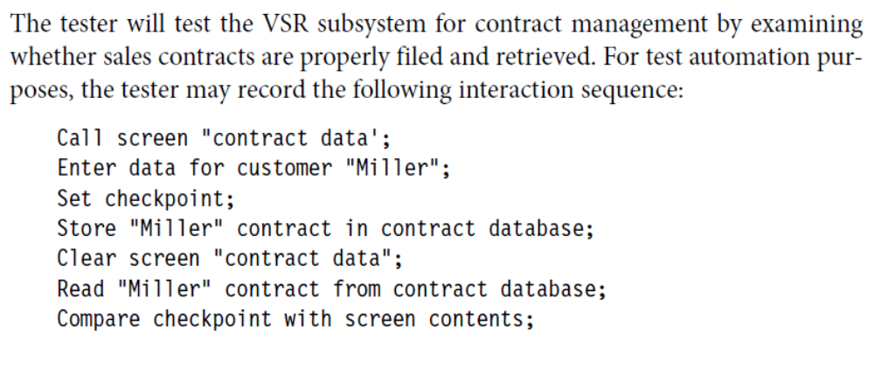
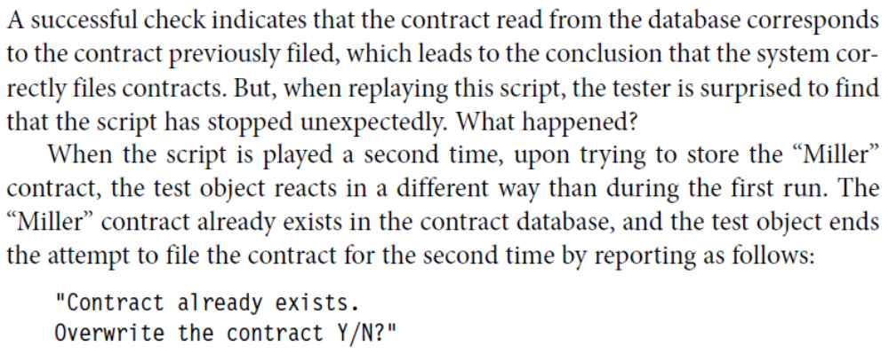
Chapter 7 Test Tools

Slide 16
Chapter 7 Test Tools
The two test runs have different preconditions. Because the captured script relies on a certain precondition (“Miller” contract not in the database), the test case is not good enough for regression test. This problem can be corrected by programming a case decision or by deleting the contract from the database as the final “cleanup action” of the test case.
In practice, this editing of captured scripts is nearly always necessary because capturing usually does not deliver scripts capable for regression testing. The following example illustrates this.
As seen in the example, it is crucial to edit the scripts by programming.Thus, implementing such test automation requires programming skills.When comprehensive and long-lived automation is required, a wellfounded test

Slide 17
Chapter 7 Test Tools
architecture must be chosen; that is, the test scripts must be modularized.
Structuring the test script and minimize the effort is to separate test data and test procedure. Usually the test data are exported into a table or spreadsheet file. Naturally, expected results must also be stored. The test script reads a test data line, executes the test procedure with these test data, and repeats this process with the next test data line. If additional test data are necessary, they are just added to the test data table without changing the script. Even testers without programming skills can extend these tests and maintain them to a certain degree. This approach is called data-driventesting.
Comparators (a further tool class) are used to identify differences Comparators between expected and actual

Slide 18
Chapter 7 Test Tools
results. Comparators typically function with standard file and database formats, detecting differences between data files containing expected and actual data. Test robots usually include integrated comparator functions operating with terminal contents, GUI objects, or screen content copies.
During test execution, tools for dynamic analysis acquire additional information on the internal state of the software being tested. This may be,for instance, information on allocation, usage, and release of memory. Thus, memory leaks, wrong pointer allocation, or pointer arithmetic problems can be detected.
Coverage analyzers provide structural test coverage values that are measured during test execution (see section 5.2). For this purpose, prior to execution, an

Slide 19
Chapter 7 Test Tools
instrumentation component of the tool inserts measurement code into the test object (instrumentation). If such measurement code is executed during a test run, the corresponding program fragment is logged as “covered.” After test execution, the coverage log is analyzed and a coverage statistic is created. Most tools provide simple coverage metrics,such as statement coverage and branch coverage (see sections 5.2.1 and 5.2.2).
7.1.5 Tools for Nonfunctional Test
There is tool support for nonfunctional tests, especially for load and performance tests. Load test tools generate a synthetic load (i.e., parallel database queries, user transactions, or network traffic). They are used for executing volume, stress, or performance tests. Tools for

Slide 20
Chapter 7 Test Tools
performance tests measure and log the response time behavior of the system being tested depending on the load input.
Load or performance tests are necessary when a software system has to execute a large number of parallel requests or transactions within a certain maximum response time. Real-time systems and, normally, client/server systems as well as web-based applications must fulfill such requirements.
Used as an analysis resource, performance test tools generally supply the tester with extensive charts, reports, and diagrams representing the system’s response time and transaction behavior relative to the load applied as well as information on performance bottlenecks.

Slide 21
Chapter 7 Test Tools
Tools for testing access control and data security try to detect security vulnerabilities. Exploiting these,unauthorized persons may possibly get access to the system. Virus scanners and firewalls can also be seen as part of this tool category, mainly because the protocols generated by such tools deliver evidence of security deficiencies.(Testing of security)
In system testing, especially in data conversion or migration projects, Data Quality Assessment tools may be used to check the data. Before and after conversion or migration,the data must be checked to make sure they are correct and complete or conform to certain syntactical or semantic rules.
7.2 Selection and Introduction of Test Tools

Slide 22
Chapter 7 Test Tools
Some elementary tools (e.g., comparators, coverage analyzers) are included in typical operating system environments (e.g., UNIX) as a standard feature.In these cases, the tester can assemble the necessary tool support using simple, available means. Naturally, the capabilities of such standard tools are limited, so it is sometimes useful to buy more advanced commercial test tools.
The area in which tool support may be advantageous strongly depends on the respective project environment and the maturity level of the development and test process.
If the process of development is chaotic and documentation does not exist or is inconsistent.....A tool can never replace a nonexistent process or compensate

Slide 23
Chapter 7 Test Tools
for a sloppy procedure.
In those situations, manual testing must first be organized. This means, initially, that a systematic test process must be defined, introduced, and adhered to.Next, thought can be given, Which process steps can be supported by tools? What can be done to enhance the productivity or quality by using tools? When introducing testing tools from the different explained categories, it is recommended to adhere to the following order of introduction:
1. Incident management
2. Configuration management
3. Test planning
4. Test execution

Slide 24
Chapter 7 Test Tools
5. Test specification
Take into account the necessary time to learn a new tool and to establish its use. Due to the learning curve, productivity may even decline for some time instead of increasing, as would be desired.It is risky to introduce a new tool.
7.2.1 Cost Effectiveness of Tool Introduction
Introducing a new tool brings with it selection, acquisition, and maintenance costs. In addition, costs may arise for hardware acquisition or updates and employee training. Depending on tool complexity and the number of workstations to be equipped with the tool, the amount invested can rapidly grow large. The time frame in which the new test tool will start to pay back is interesting, as with every investment.

Slide 25
Chapter 7 Test Tools
Test execution automation tools offer a good possibility for estimating the amount of effort saved when comparing an automated test to a manually executed test. The extra test programming effort must, of course, be taken into account. This typically results in a negative cost-benefit balance after only one automated test run. The achieved savings per test run accumulate only after further automated regression test runs(the following figure).To summarize:
■ Tools may support the creative testing tasks. They help the tester to improve test quality.
■ Mechanical test execution may be automated. This reduces test effort or makes it possible to run more tests with the same test effort. However,more tests do not necessarily mean better test quality.

Slide 26
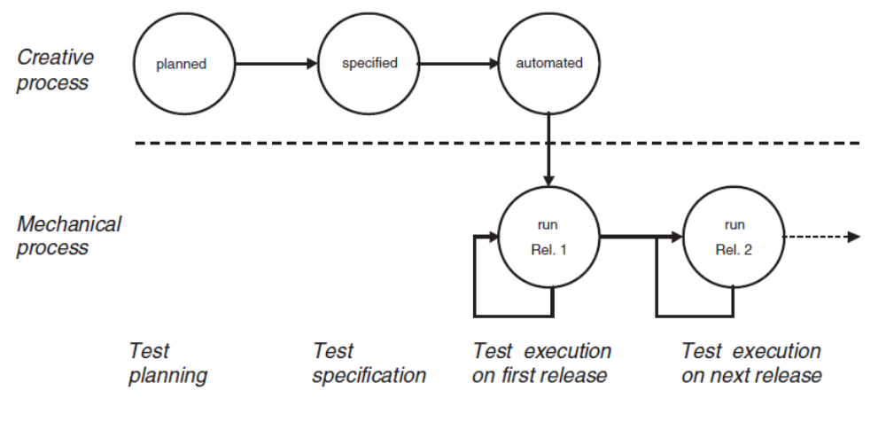
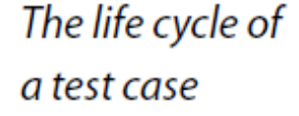
Chapter 7 Test Tools

Slide 27
Chapter 7 Test Tools
■ In both cases, without good test procedures or well-established test methods, tools do not lead to the desired cost reduction.
7.2.2 Tool Selection
After a decision is made about which test task a tool shall support, the actual selection (and evaluation) of the tool starts. As explained earlier, the investment can be very large. It is, therefore, best to proceed carefully and in a well-planned way. The selection process consists of the following five steps:
1. Requirements specification for the tool
2. Market research (creating a list of possible candidates)
3. Tool demonstrations
4. Evaluation of the tools on the short list

Slide 28
Chapter 7 Test Tools
5. Review of the results and selection of the tool

